Slide 1
STROKE ACTION PLAN EUROPE Webinar
19.10.2021
SAP-E ESSENTIALS OF STROKE CARE
An overview of evidence-based interventions covering the entire chain of stroke care.
Steiner T, Turc G, Dawson J, Sunnerhagen KS, Christensen H

Slide 2
SAP-E ESSENTIALS OF STROKE CARE
What was the document made for?
to assist the implementation of the ESO Action Plan for Stroke in Europe (SAP-E) by
to provide a simple overview of evidence-based stroke care and treatment to
to highlight the essential steps defining good basic stroke care through the chain of care from the pre-hospital setting to life after stroke

Slide 3
SAP-E ESSENTIALS OF STROKE CARE
What it is not
This is not a guideline according to the ESO standard procedure on preparation of guidelines or a replacement for local detailed guidelines

Slide 4
SAP-E ESSENTIALS OF STROKE CARE
Methods: How was this Basic Care Manual prepared?
Prepared by a sub-committee established by the ESO Guideline Board by request from the Stroke Action Plan Europe Implementation Steering Committee:
Steiner T, Turc G, Dawson J, Sunnerhagen KS, Christensen H
Recommendations from high-quality guidelines translated into a practical list of what to do and what not to do:
ESO guidelines wherever existing
If there were no ESO guideline, GRADE-based guideline were preferred
If there were no GRADE-based guideline, best existing guideline based on consensus
Approval of the final document by
Implementations Steering Committee of SAP-E
ESO Guideline Board
ESO Executive Committee

Slide 5
SAP-E ESSENTIALS OF STROKE CARE
Which parts over the course of the disease are covered?
Chain of care: Pre-hospital → life after stroke
How where recommendations graded?
We pragmatically harmonized gradings into „must do“, „consider doing“ and „don’t do“
Inform the reader on the quality and type of source:
EBR: evidence-based recommendation
SR: systematic review
MA: meta-analysis
RCT: randomized controlled trial
CS: consensus statement
RA: research article

Slide 6
SAP-E ESSENTIALS OF STROKE CARE
Overview of covered aspects
Pre-hospital management
On arrival with suspected stroke
Acute reperfusion treatment
Initiate acute pharmacological therapy
Acute stroke unit care
Stroke unit rehabilitation and care/early supported discharge
Prevention of complications
Further work up during stroke unit stay
Carotid artery disease
Secondary prevention: Pharmacological
Secondary prevention: Non-pharmacological – life-style modifications
After discharge (involvement of relatives, monitoring, check-ups)
Life after Stroke

Slide 7
SAP-E ESSENTIALS OF STROKE CARE
Two examples

Slide 8
Acute reperfusion treatment
Must do | Source | Type of source
Blood glucose must be measured before start of IVT | [9] | EBR
IVT with alteplase in potentially disabling stroke, also minor, within 4.5 hours of onset, irrespective of age; unless contraindications are present | [10] | EBR
Reperfusion therapy (IVT and / or MT based on individual considerations) in basilar large vessel occlusion within 6 hours of onset. | [7,10] | EBR
Reperfusion therapy (IVT and/or MT) in selected patients in the late window with favorable imaging profiles, as detailed in specific guidelines | [7,10] | EBR
7. Turc G et al. ESO Guidelines on Mechanical Thrombectomy in Acute Ischemic Stroke. European Stroke Journal 2019;4
9. Boulanger JM et al. Canadian Stroke Best Practice Recommendations for Acute Stroke Management: IJS 2018;13:949-984
10. Berge E et al.. ESO guideline for intravenous thrombolytic treatment for acute ischaemic stroke. ESJ 2021

Slide 9
Life after Stroke
Aspect | Must do | Source | Type of source
Follow-up | Patients should be followed up after stroke for functional decline and new symptoms including pain, e.g. by use of the post-stroke check list, [35] and referred if relevant | [36] | EBR
Involvement, support and education of patients and relatives | Patients and relatives should be involved in making care plans and other planning or decisions for life after stroke and receive appropriate support and education | [36] | EBR
Driving | Assessment for driving ability should be performed according to local legislation | [36] | EBR
Participation (social, work, leisure-time activities) | Individual assessment should be performed, and referral and counseling provided when relevant | [36] | EBR
Relationships/sexuality | Education and counseling should be provided | [36] | EBR
Disability support | Care plans should be completed, and applications made in a timely manner | [36] | EBR
Advanced care planning | Advanced care planning should be made and periodically reviewed. | [36] | EBR
Transition to long-term care | Discharge summary and care plan should be present on admission to long term care In case of ongoing rehabilitation goals, there should be access to relevant rehabilitation services. In case of changes in status, there should be access to reevaluation and rehabilitation | [36] | EBR
Heart and Stroke. Transitions and Community Participation Following Stroke - Section 5: Transition to Long-Term Care Following a Stroke. https://www.strokebestpractices.ca/recommendations/managing-stroke-transitions-of-care/transition-of-patients-to-long-term-care-following-a-stroke, 2020

Slide 10
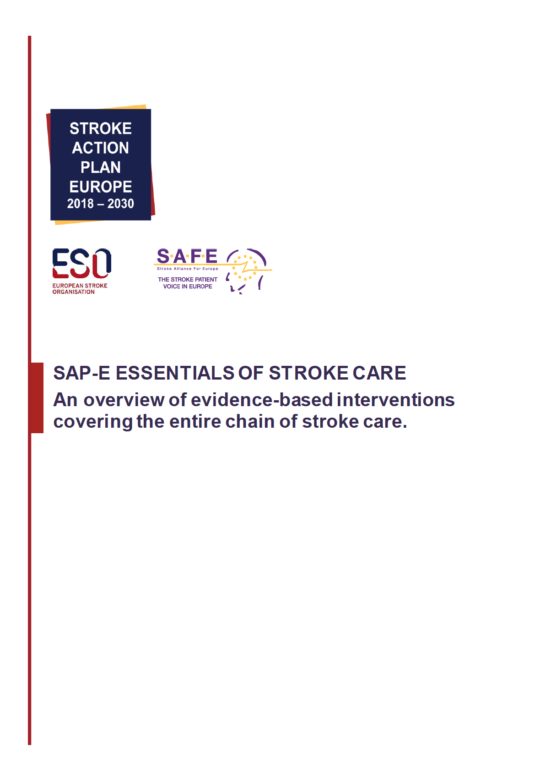
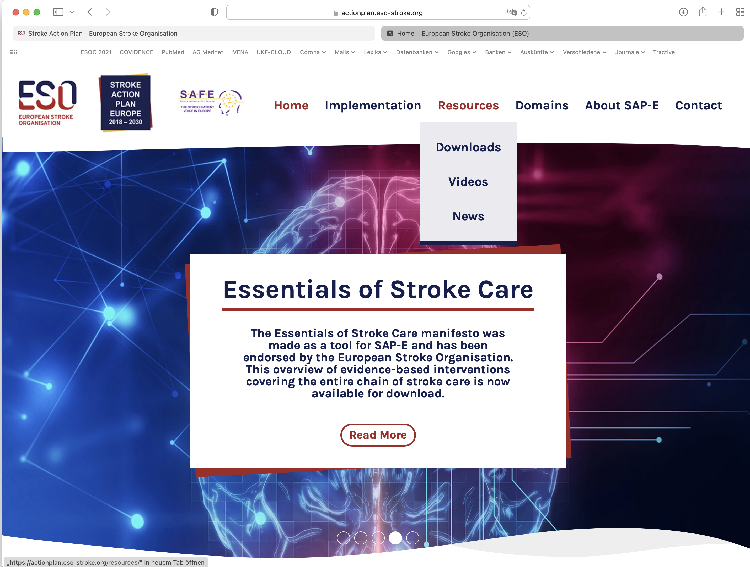
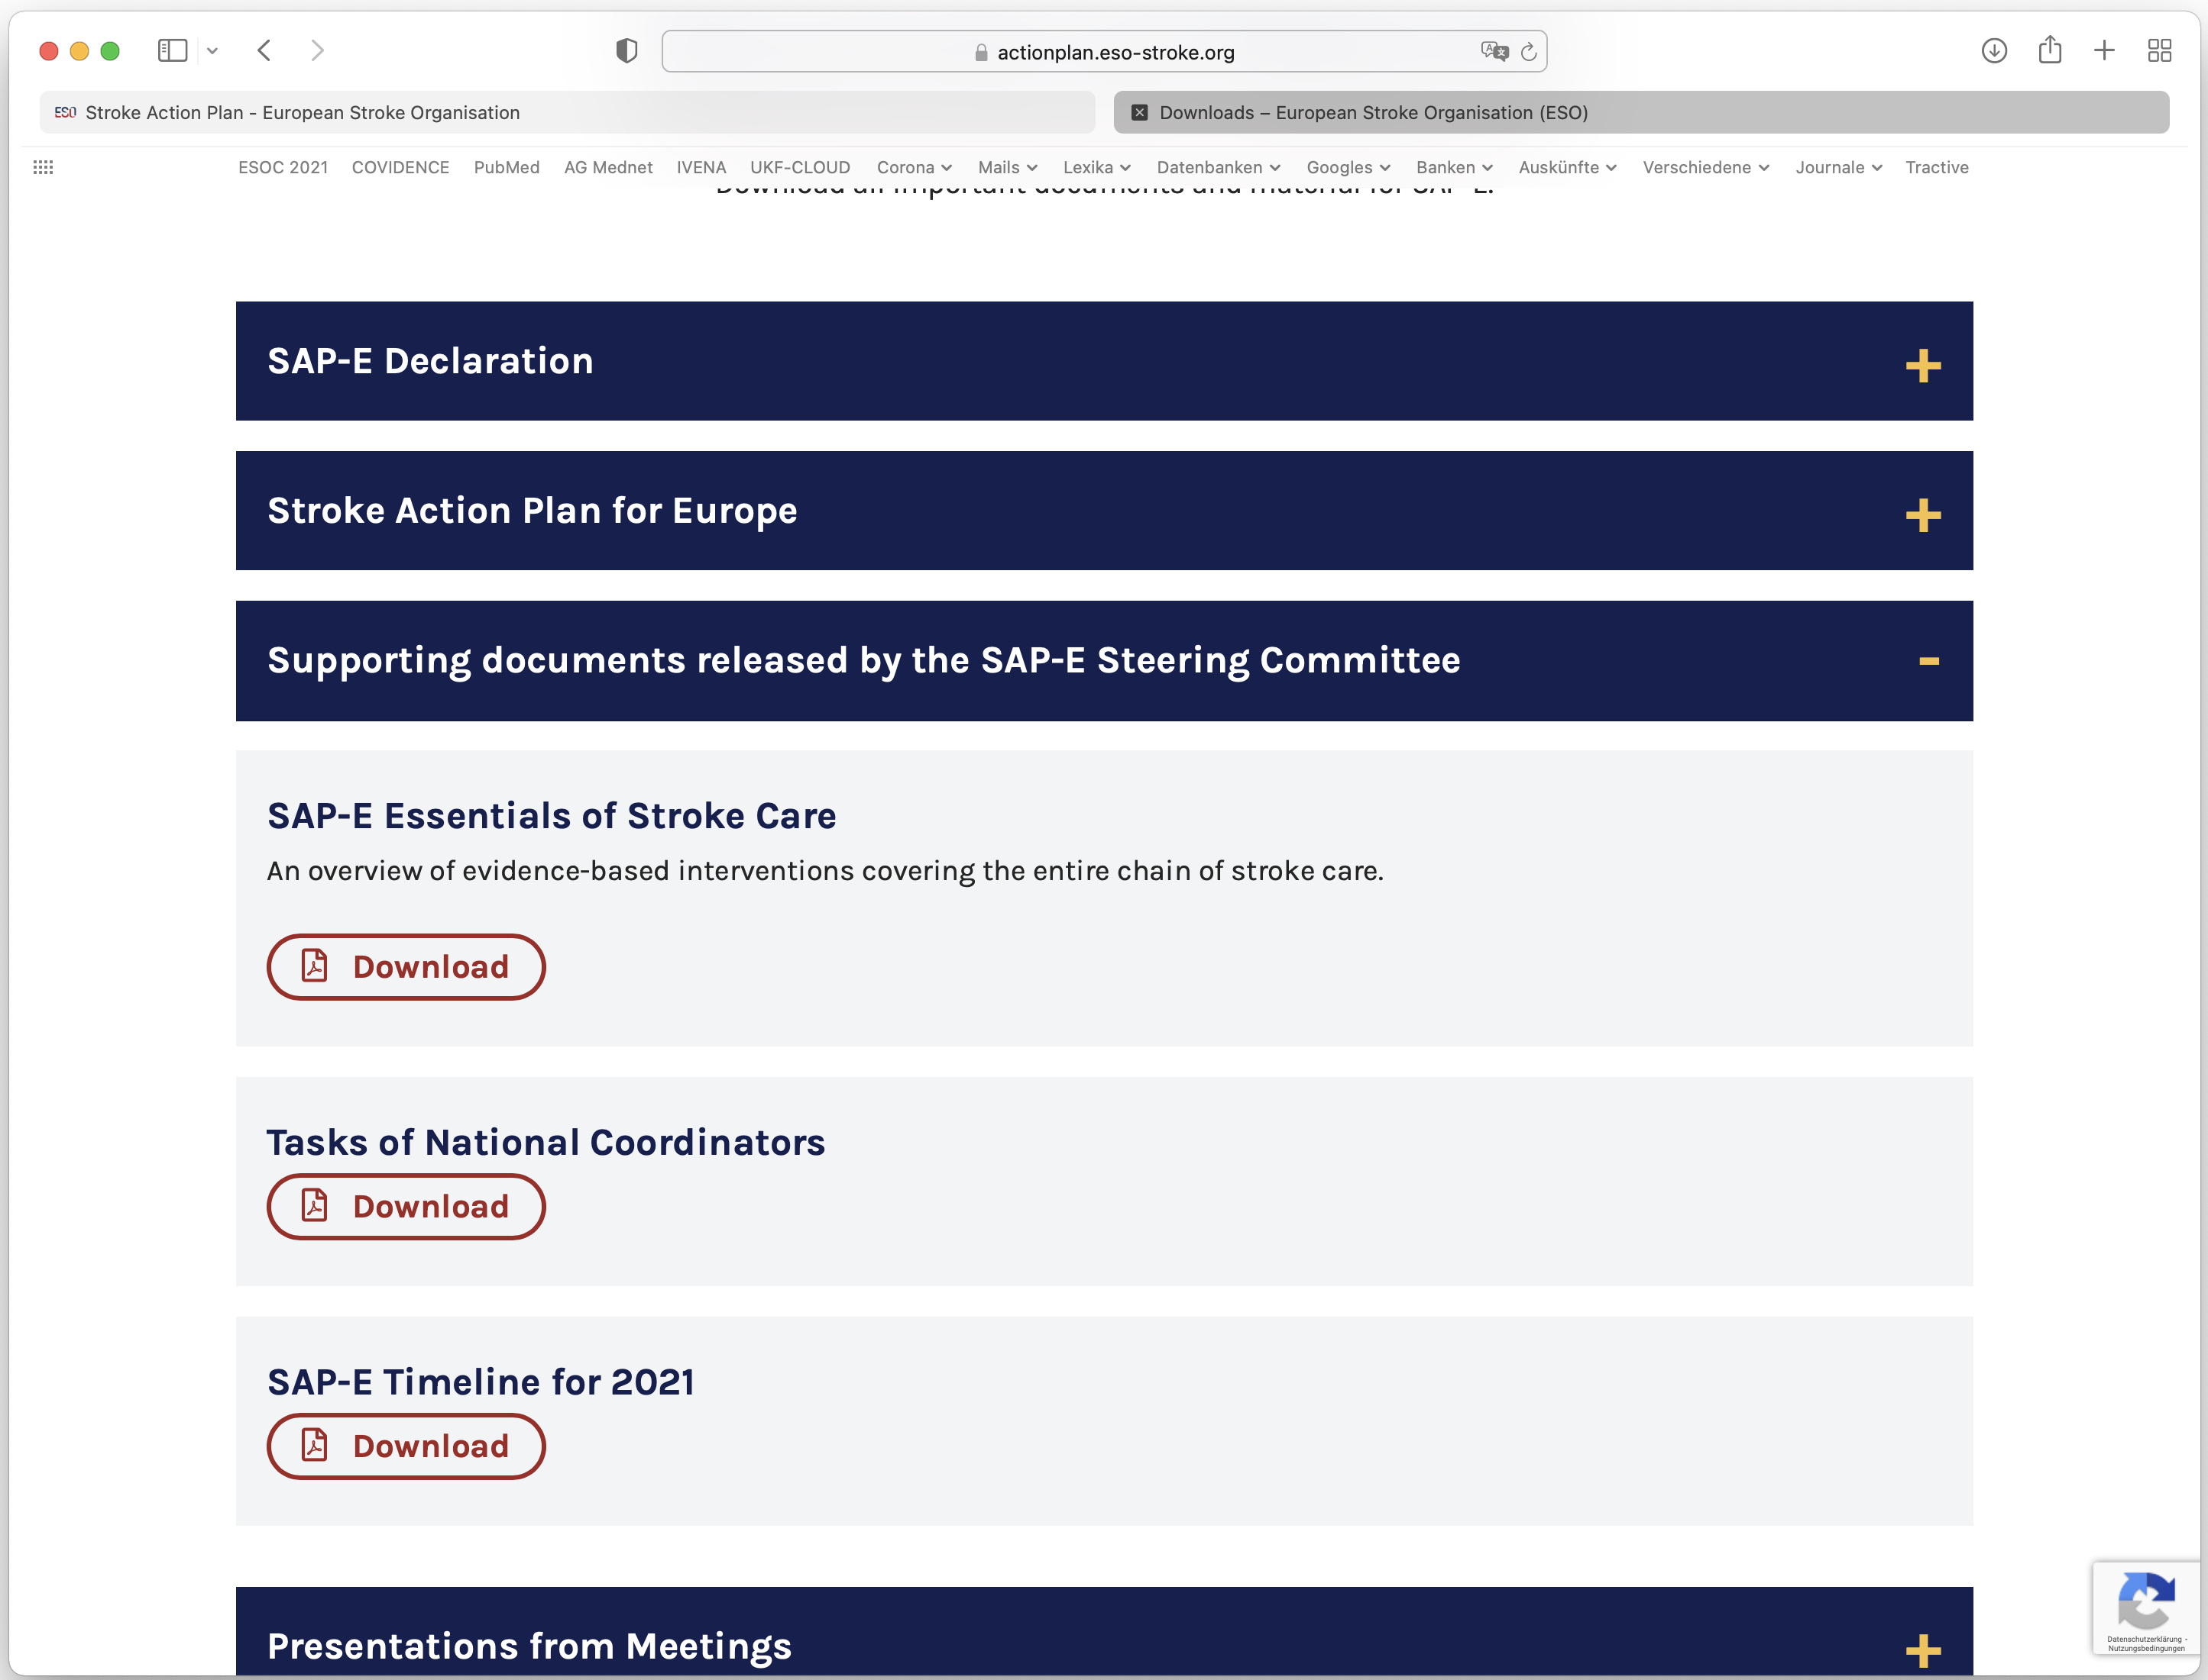
How to get to the SAP-E Essentials of Stroke Care
Go to SAP-E Homepage: https://actionplan.eso-stroke.org
Click on Resources
Select Downloads
Click on „Supporting documents released by the SAP-E Steering Committee“
Download (PDF): „SAP-E Essentials of Stroke Care“

Slide 11
Thank you

